Slide 1
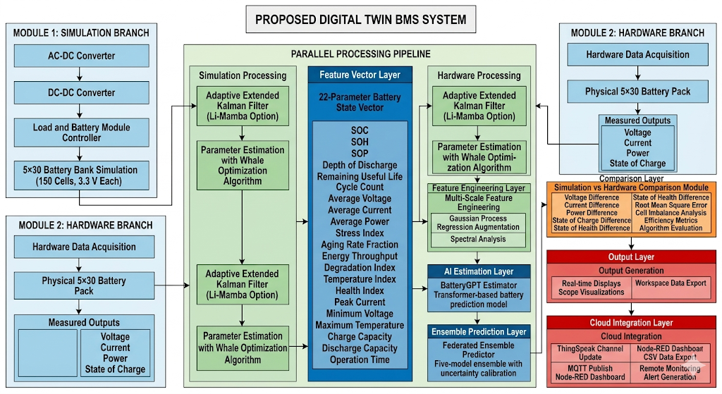
2. Proposed Digital Twin BMS System (Generated)

Slide 2
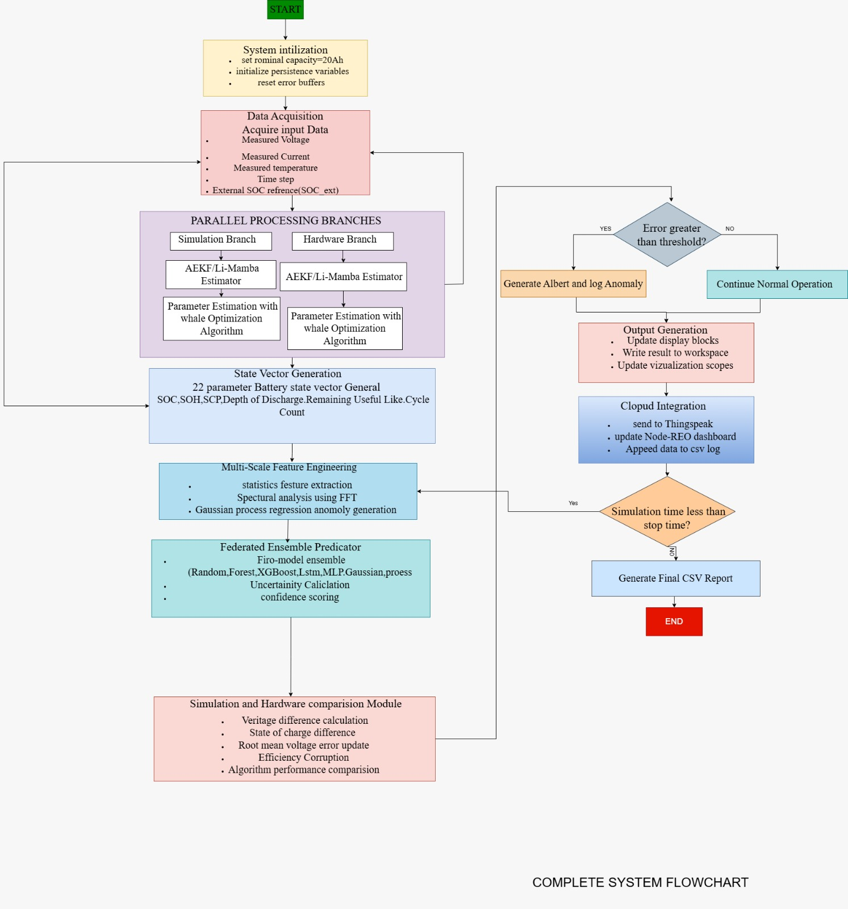
3. Complete System Flowchart

Slide 3
Digital Twin Battery Management System with Federated Ensemble and Li-Mamba Integration
START
Feature Engineering
Initialization
Multi-scale window extraction
Statistical feature computation
Down sampled sequence analysis
Gaussian process anomaly detection
Error Metrics Computation
Nominal capacity = 50Ah
Sliding window size = 100
Step size = 10
Ensemble model count = 5
Maximum buffer length = 200
Initialize feature buffers
Initialize error buffers
Initialize ensemble model parameters
Initialize Li-Mamba state space model
Set training timers and counters
RMSE voltage
RMSE current
RMSE SOC
RMSE SOH
Charging efficiency
Coulombic efficiency
Battery Measurement Acquisition
Battery GPT Transformer Prediction
System Output Generation
Measured voltage V meas
Measured current I meas
Measured temperature T meas
Query-Key-Value attention computation
Self-attention representation learning
Feed-forward neural prediction
SOC and SOH estimation
Sampling interval dt
External SOC reference
Real-time display update
Visualization scope update
Workspace data storage
Hardware Sensor Acquisition
Federated Ensemble Predictor
Simulation Battery Model
Simulated voltage calculation
Simulated current update Simulated temperature update
Voltage sensor reading
Current sensor reading
Temperature sensor reading
Individual model predictions
Weighted ensemble aggregation
Aleatoric uncertainty estimation
Epistemic uncertainty estimation
Confidence calculation
Cloud Communication
State Estimation using AEKF and Li-Mamba
Thing Speak data upload
Node-RED dashboard update
CSV log storage
Coulomb counting prediction
Sequence buffer update
Li-Mamba state space feature extraction
Voltage measurement correction
Kalman gain computation
SOC estimation update
Adaptive Model Training
Simulation complete?
Battery Parameter Computation
Bootstrap dataset sampling
Linear regression weight update
Ensemble uncertainty evaluation
NO
SOC
SOH
SOP
Depth of Discharge
Remaining Useful Life
Cycle Count
Average voltage
Average current
Average current
Average power
Stress index
Aging rate fraction
Energy throughput
Degradation index
Temperature index
Health index
Temperature index
Health index
Peak current
Minimum voltage
Maximum temperature
Charge capacity
Discharge capacity
Operation time
Simulation and Hardware Comparison
YES
Voltage difference
Current difference
SOC difference
SOH difference
Final Report Generation
Generate CSV Report
Plot comparison Results
END
4. Algorithm for the proposed method

Slide 4
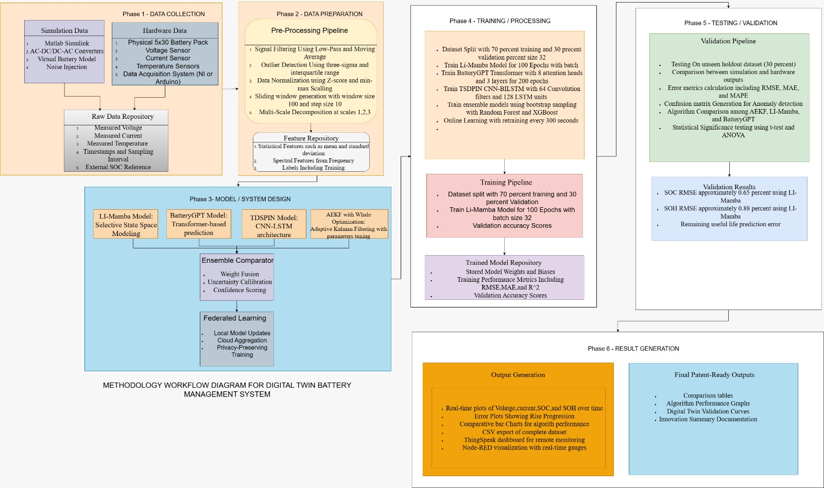
5. Methodology Workflow Diagram

Slide 5
6. Experimental Setup Diagram
HARDWARE ENVIRONMENT
Module 2:
10 cells, 3.3 V each
Battery Hardware Setup
Module 4:
10 cells, 3.3 V each
Module 5:
10 cells, 3.3 V each
Module 1:
10 cells, 3.3 V each
Module 3:
10 cells, 3.3 V each
Battery Pack
5 x 30 configuration, 150 total cells,
495 V nominal voltage
Voltage Sensor:
Per-cell voltage monitoring
Sensor Layer
Current Sensor:
Hall-effect measurement
Temperature Sensor:
Module-level temperature sensing
Data Acquisition System
National Instruments DAQ or Arduino Due
16-bit analog-to-digital conversion
Sampling frequency from 1 to 10kHz
Communication Interface
Serial or USB Communication
SOFTWARE ENVIRONMENT
MATLAB and Simulink Platform
Fixed-step solver using ode23 with time step 0.01 seconds, Simscape Electrical
For battery modeling, Deep Learning Toolbox for Li-Mamba and transformer models,
Statistics and Machine Learning Toolbox, Signal Processing Toolbox for FFT,
Parallel Computing Toolbox for ensemble training, IoT Toolbox for Thing Speak integration
Custom Algorithm Implementations
Li-Mamba selective state space modeling, Battery GPT transformer attention mechanism,
Whale optimization for parameter tuning, Gaussian process regression anomaly detection
Federated ensemble with uncertainty calibration, Multi-scale feature engineering
Data Acquisition
Pre-processing
Execution Pipeline
Core Intelligence
Post-Processing
Real-Time Streaming
Feature Extraction
Model Inference
Output Generation
Thing Speak Cloud
Channel ID configuration
API Key authentication
Eight data fields for monitoring
Output Generation and Visualization
Node-RED Dashboard
Real-time gauges
Historical trend plots
Alert notifications
CSV Data Export
comparison results, training data,
Model weights

Slide 6
7. Functional Layer Architecture

Slide 7
8. Dataflow Diagram
External Entities
Physical Battery
Cloud Thing Speak
User/Operator
Processing Modules
Input sensor signals
(voltage, current, temperature)
Process 1 : Data Acquisition
Input : Voltage, Current, Temperature
Output : Raw Data + Timestamp
Task : Sampling + Unit conversion
Process 10 : Cloud Integration
Output : Thing Speak + Node-RED dashboard
Task : MQTT publish + channel update
Simulation Parameters
Process 2 : Pre-Processing
Input : Raw data
Output : Filtered signals + windows
Task : Filtering, normalization, windowing
Process 9 : Output Generation
Output : Displays, scopes, CSV logs
Process 3 : State Estimation
Input : Filtered V, I, T
Output : SOC, Vp1, Vp2, R0, OCV
Task : AEKF / Li-Mamba prediction
Process 8 : Comparison
Input : Simulation vs Hardware parameters
Output : Errors, RMSE, efficiency metrics
Process 4 : Parameter Estimation
Input : Estimated states + measurements
Output : 22-parameter Battery Vector
Task : WOA optimization + cycle counting
Process 7 : Federated Ensemble
Input : Prediction outputs
Output : Final SOC, SOH, RUL
Task : Ensemble learning + uncertainty
Process 5 : Feature Extraction
Input : 22-parameter vector
Output : Feature vector + anomaly score
Task : Multi-scale states + spectral analysis
Process 6 : BatteryGPT Prediction
Input : Features
Output : SOC_pred, SOH_pred, RUL_pred
Task : Transformer based prediction
Data Stores
D1 : Raw Data Buffer
D2 : Window Repository
D3 : Feature Store
D4 : Model Weights
D5 : Error History
D6 : Log File

